Slide 1
Introduction to Statistics and Data Visualization

Slide 2
Outline
Overview – What are the benefits?
Working with Data
Plotting Data
Descriptive Statistics
Inferential Statistics
Correlation and linear regression

Slide 3
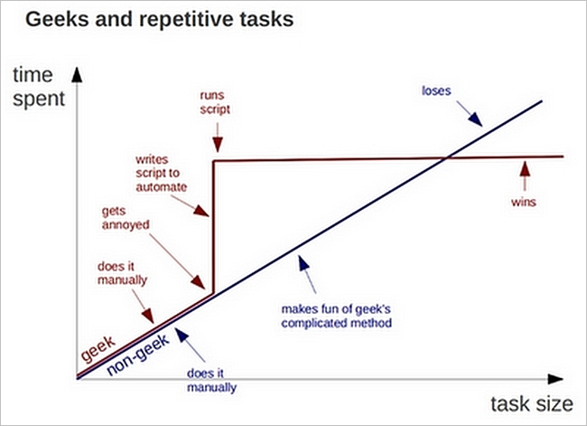

Slide 4
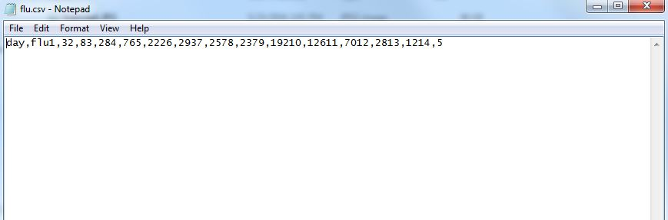
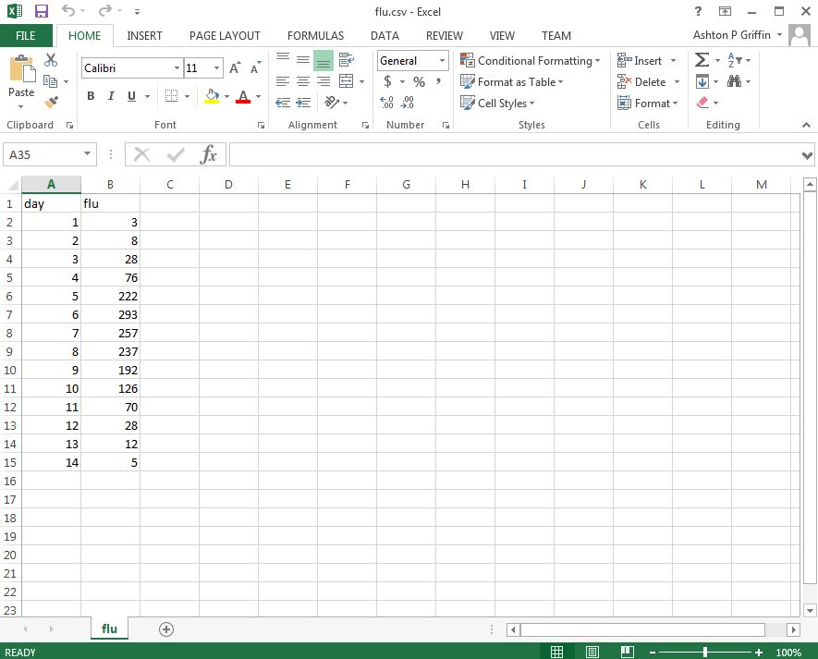
Exercise 1. To confirm this, open the flu.csv in a text editor (such as Notepad) and a spreadsheet program (such as Microsoft Excel). Describe what you see.

Slide 5
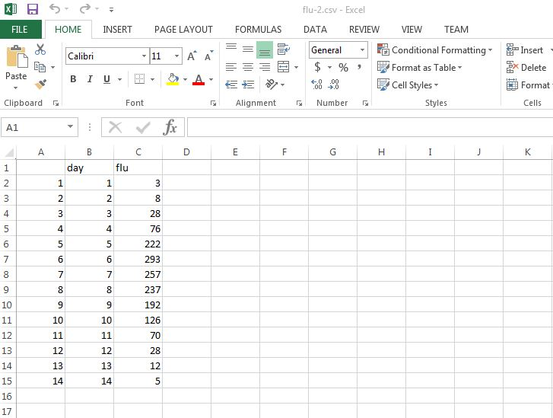
Exercise 2. To use write.csv one needs to know what arguments to provide. Review the help files for write.csv and save the flu data frame to a new file flu-2.csv. View flu-2.csv in a text editor. How is flu-2.csv different than the original file flu.csv?
Code:
write.csv(flu, file="flu-2.csv")

Slide 6
Exercise 3. Explain how the line rm(list=ls(all=TRUE) works.
Exercise 4. What would have happened if we didn’t clear the workspace before loading the new data? How can you check?

Slide 7
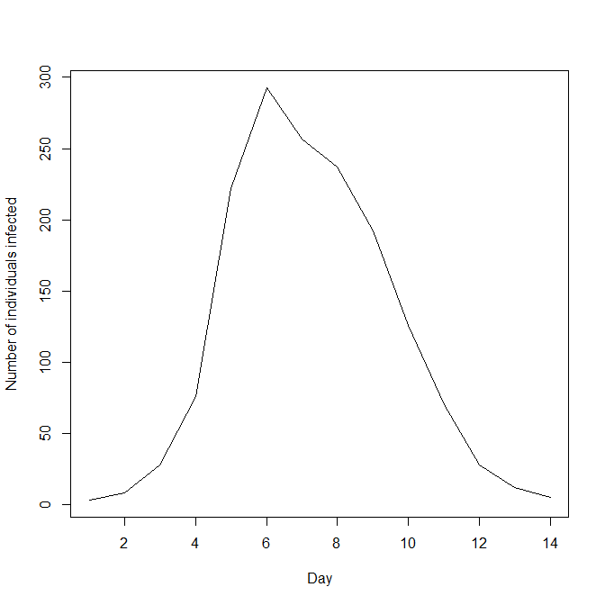
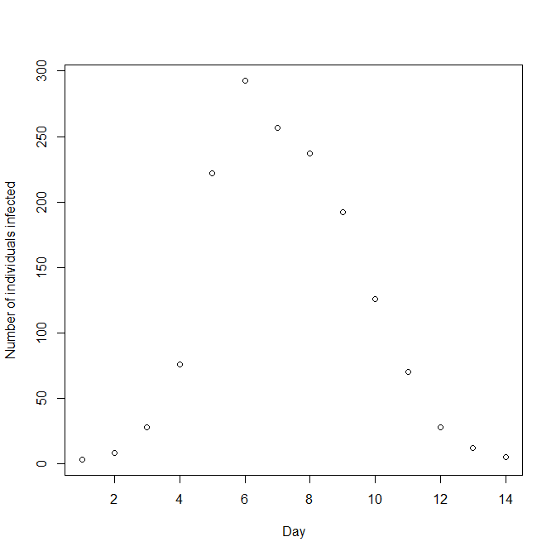
Exercise 5. The plots generated above consists of ‘b’oth points and lines, hence the argument type=‘b’. Retrieve the help for the plot function and try some of the other plot types, e.g., line plot and point plot.
type = ‘l’
type = ‘p’

Slide 8
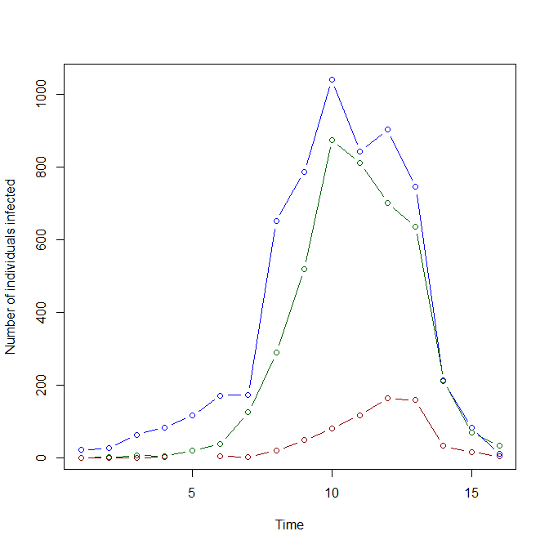
Exercise 6. Experiment with the functions plot, lines, and points by plotting the measles incidence data from three different districts int eh city of Niamey, Niger in different colors in the same figure.
The first step you’ll want to take is to familiarize your self with the data. How can you distinguish what the districts are? What is different from this data set and the flu data set?
View(niamey)
length(niamey$V1)
biweek <- seq(1,16,1)
plot(biweek, niamey$V1, type='b', col='blue',ylab="Number of individuals infected", xlab='Time')
lines(niamey$V2, type='b', col="darkgreen")
lines(niamey$V3, type='b', col="darkred")

Slide 9
Exercise 8. Scoring missing values as NA is different than treating them as zero. Numerically show this to be the cases using the data on measles in the third Niamey district.
niamey.na <- niamey[,3]
niamey.na.to.zero <- niamey[,3]
niamey.na.to.zero[is.na(niamey.na.to.zero)] = 0
mean(niamey.na, na.rm=TRUE)
mean(niamey.na.to.zero)
Data Frame | Mean
With NA | 43.46667
NA set to Zero | 40.75
Why do you think there is a discrepancy between the two data sets?

Slide 10
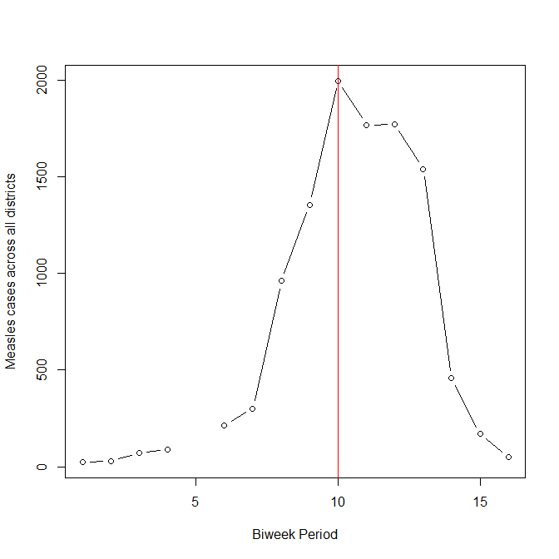
Exercise 9. Practice using other descriptive statistics. First, numerically find in which biweek/district combination the greatest number of cases were reported. Second, determine in which biweek there was the greatest dispersion among cases, Visually verify your results by plotting.
which(rowSums(niamey, na.rm=TRUE)==max(rowSums(niamey,na.rm=TRUE)))
rowSums(niamey)[10]
biweek.sum <- rowSums(niamey)
biweek <- seq(1,16,1)
plot(biweek,biweek.sum,type='b',ylab='Measles cases across all districts',xlab="Biweek Period")
max <- which(biweek.sum == max(biweek.sum, na.rm=TRUE))
abline(v= 10,col='red')

Slide 11
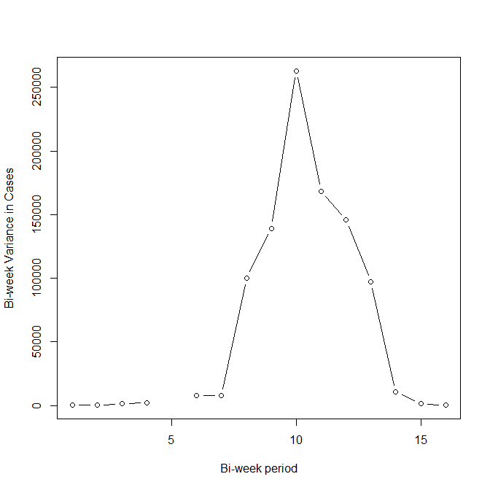
Exercise 9. Practice using other descriptive statistics. First, numerically find in which biweek/district combination the greatest number of cases were reported. Second, determine in which biweek there was the greatest dispersion among cases, Visually verify your results by plotting.
biweek.var <- t(diag(var(t(niamey))))
biweek.sd <- NULL
for( i in 1:length(niamey$V1)){
biweek.sd[i] <- sd(niamey[i,], na.rm=TRUE)
}
plot(biweek, biweek.var, type="b", ylab='Bi-week Variance in Cases', xlab='Bi-week period')

Slide 12
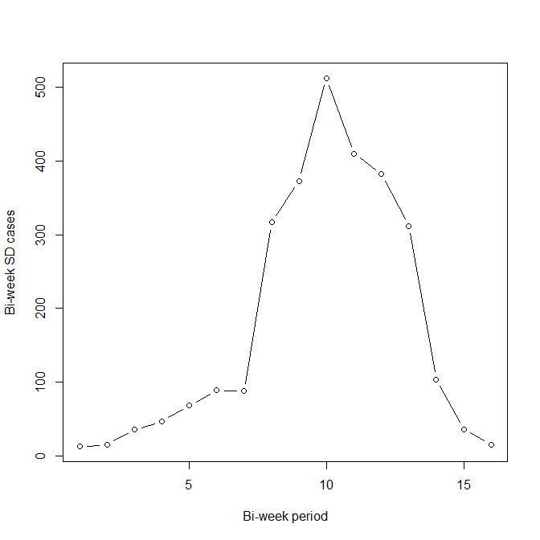
Exercise 9. Practice using other descriptive statistics. First, numerically find in which biweek/district combination the greatest number of cases were reported. Second, determine in which biweek there was the greatest dispersion among cases, Visually verify your results by plotting.
plot(biweek, biweek.sd, type="b", ylab='Bi-week SD cases', xlab='Bi-week period')
boxplot(t(niamey), xlab="Bi-week period", ylab='Infected Individuals')

Slide 13
Exercise 10. Now, try using the apply function to repeat the previous exercise.
cases <- apply(niamey, MARGIN=1, FUN=sum, na.rm=TRUE)
which(cases==max(cases))
var <- apply(niamey, MARGIN=1, FUN=var, na.rm=TRUE)
which(var==max(var))
sd <- apply(niamey, MARGIN=1, FUN=sd, na.rm=TRUE)
which(sd==max(sd))

Slide 14
Exercise 11. Test for differences in the mean number of cases between districts 1 and 3 and between districts 2 and 3. How do you interpret these results?
t.test(niamey[,1], niamey[,3])
t.test(niamey[,2], niamey[,3])

Slide 15
Exercise 12. Test for a correlation in the number of cases reported in Niamey districts 1 and 2. Explain your result.
cor.test(niamey[,1],niamey[,2])

Slide 16
Exercise 13. The default measure of association returned by cor.test is called Pearson’s correlation coefficient. However, there are actually several different concepts of correlation which differ in technical ways. Another of these is called Spearman’s rank-order coefficient and may be calculated by using the argument method=‘spearman’. Can you surmise how Spearman’s correlation differs from Pearson’s? Devise a means to calculate Spearman’s correlation coefficient without using the argument method=‘spearman’.)
cor.test(niamey[,1],niamey[,2], method='spearman')

